Slide 1
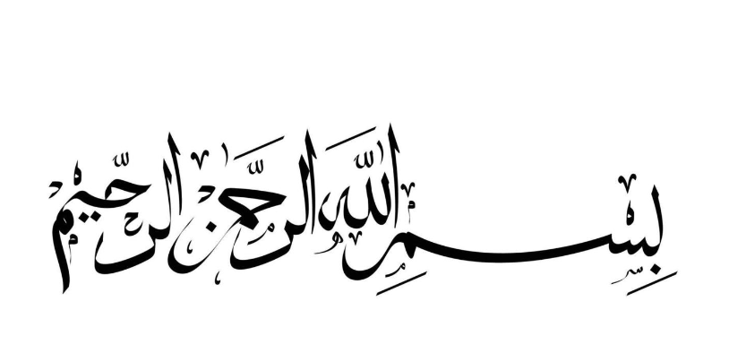

Slide 2
PYTHON
By:
Mahroosha Riaz and Izza Laraib

Slide 3

Introduction
PYTHON is one of the popular interpreter programming language in the world, which was created in 1991 by “Guidovan Rossum”

Slide 4
Python can be used for
Web development
Software development
Mathematics

Slide 5
In Python there is no need to write data type before the declaration of any variable. It use interpreter to understand the data type of variable according to the value. In C++: int a=1; In Python: a=1

Slide 6
Declaration of variables
In Python
In C++
a=1
Print(a)
#include<iostream>
using namespace std;
main( )
{
int a=1;
cout<<a;
}

Slide 7
Data types
Mutable
Immutable
List
Set
Dictionaries
“in which you can change data after the declaration”
Number
String
Tuples
“in which you can not change data after the declaration”

Slide 8
Immutable

Slide 9
Number
Integer
Float
Complex
Integer is a whole number with
no decimal place.
They reserve 4-byte.
Example:
1 is an integer
It is a number with a decimal place
They reserve 4-byte.
Example:
7.6 is a float.
It is in the form of a+bj where a is real number and bj is imaginary number.
Example:
2+7j

Slide 10
String
" string is a collection of one or more characters put in a single quotes, double quotes or triple quotes "
In python there is no character data type, a character is a string of length.
It is represented by str.
In Python:
name = "muhammad"
print(name)
In C++:
char str[ ]="muhammad";
cout<<str<<endl;

Slide 11
Tuples
" Tuple is also a heterogeneous collection of python objects separated by commas, objects of different data types "
It reserve 4-bytes.
EXAMPLE:
number = 4, 2.6, 8+24j
print(number)

Slide 12
Mutable

Slide 13
List
" it is a heterogeneous collection of items of different data type"
It reserve 4-bytes.
EXAMPLE:
Student =["Hira", "0.5", "215"]
print(student)

Slide 14
Dictionaries
"it is not an ordered collection, so a values cannot be accessed using an index in square bracket"
It reserve 4-bytes .
Example:
Capital_city={‘Pakistan':’Karachi',’Italy':’Rome'}

Slide 15
Set
"A set is a collection of data type in Python, same as list and tuple".
It reserved 4-bytes per element
Example:
{1,2,3}

Slide 16


